Slide 1
TOURS AND TRAVELS WEB APPLICATION
No more monotonous holiday
Team members:
K.Kavya(20CS1057),
B.Kiruthika(20CS1058).

Slide 2

Problem
Statement
Ideas for vacation planning
Planning to execute the tour with all amenities is tiring
Surfing internet for each and every need
Difficulty in managing details of users and bookings
Lack of information about events

Slide 3

OBJECTIVES
Independent travel planning
All amenities in single platform
Simple and easy process
Exploration platform with added entertainment
Manages details of users and admins, clear record of bookings and payment

Slide 4
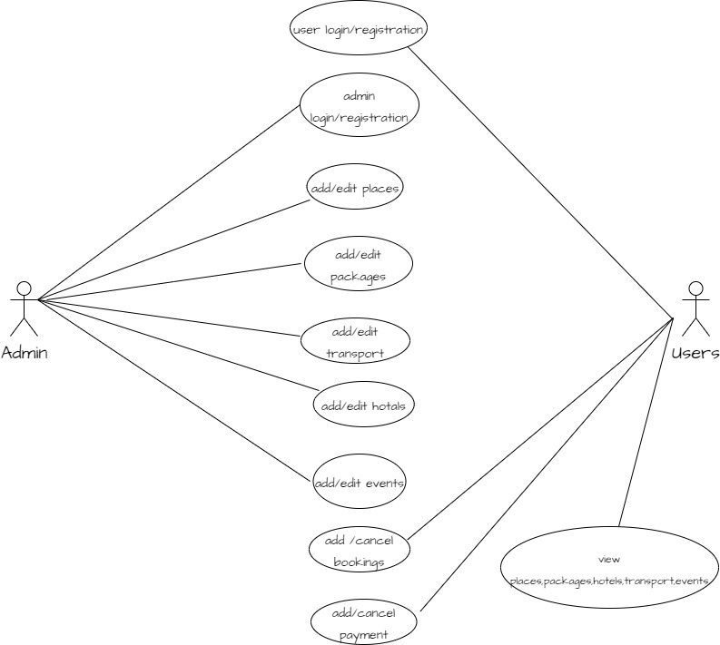
Use Case Diagram

Slide 5
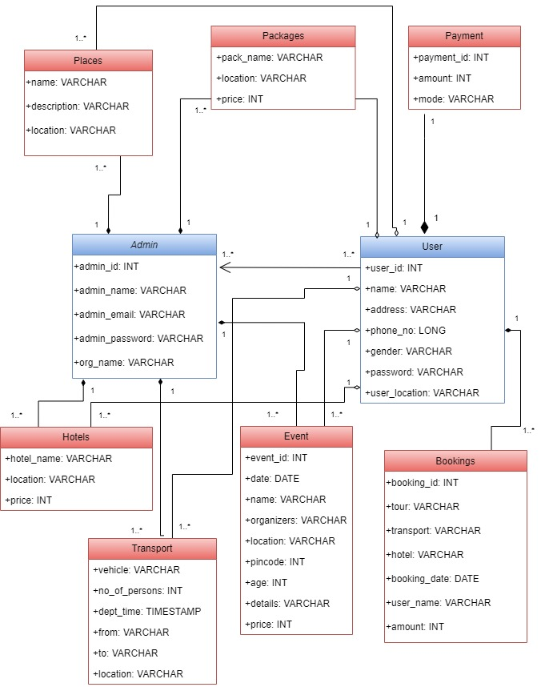
Class Diagram

Slide 6
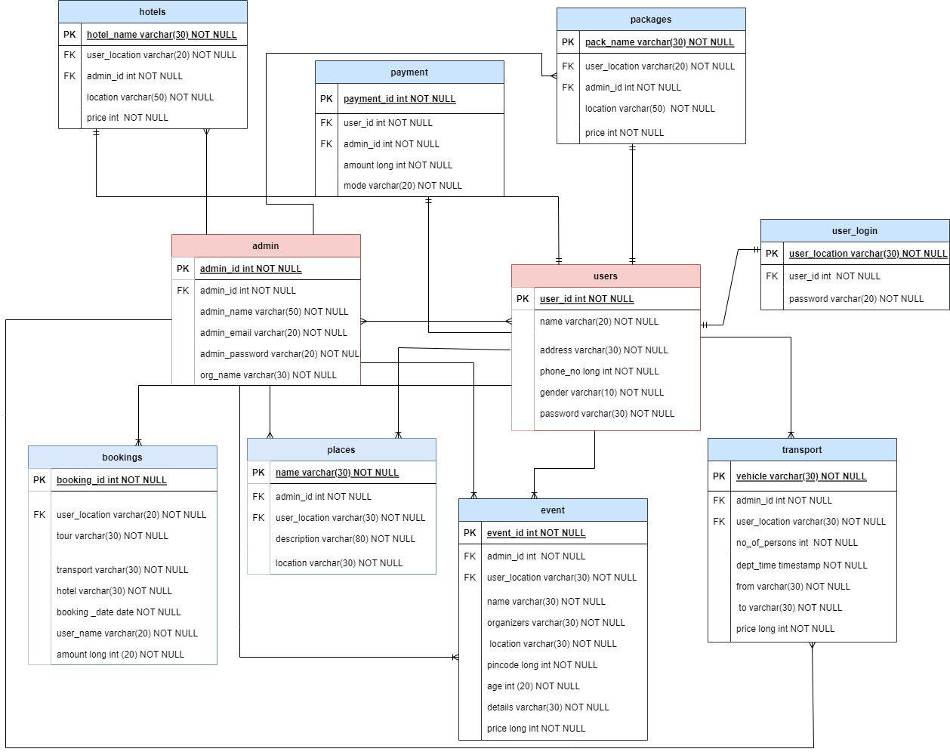
E-R Diagram

